Slide 1
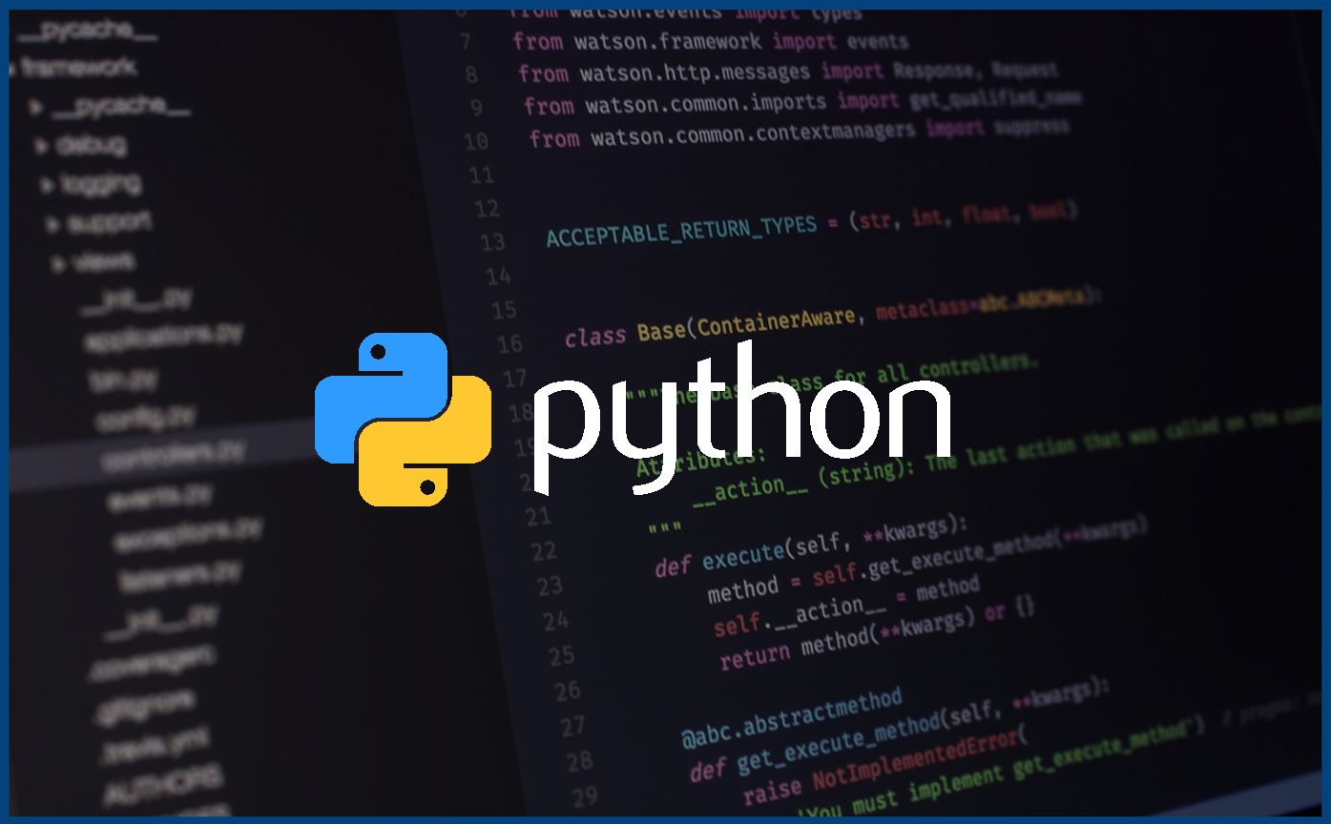
Introduction to Python!

Slide 2
1.
Variables and Data Types

Slide 3
Basic Data Types in Python
Integers: A whole number it can be any value between -2147483647 and 2147483647
Floats: Decimal number representation
Strings: We covered strings a bit last week. What else can we do with them?
Booleans: this data type can either be True or False. Very important for evaluating conditional logic

Slide 4
Let’s look at integer operations

Slide 5
What can we do with integers?
Comparisons
Mathematical Operations
Syntax:
Addition: +
Subtraction: -
Multiplication: *
Division: /
Exponent: **
Modulo: %
Float values are the same, but represent decimal numbers
Lets try some examples

Slide 6
What can we do with Strings?
We know that they are used to store text
Strings are immutable
This means that once a string is defined, it cannot be changed
This is not a big deal since we can redefine the string
String methods:
We know about lower and upper
There are A LOT more
https://www.w3schools.com/python/python_ref_string.asp
String Indexing: we can get specific parts of a string

Slide 7
Type conversion
There are two types of type conversion in python
Implicit Conversion
This is when the Python Interpreter automatically converts a data type to another without any user involvement
example : redefining variables
Explicit type conversion
The data type is manually changed by the user
We use some built in functions for this
int(my_variable)
str(my_variable)
float(my_variable)
There are many more than this but we will cover those later

Slide 8
Python Syntax
Last week, we covered what syntax meant. Lets see how we can write the best looking code possible.

Slide 9
snake_case
snake_case is a method of writing variable names with lowercase letters and underscores to separate words
It is not a requirement for Python but it makes the code more readable and uniform
first_name, or favourite_food are examples of this

Slide 10
Indentation
Indentation is necessary for Python to work
It defines the “scope” of code and with improper indentation, your code will not run
Let’s look at some improper examples

Slide 11
Exercise 1:
Let’s write a simple program, which takes some input and tells the user if the number is even or odd.
This will help us practice type conversions and boolean values

Slide 12
Exercise 2:
We are going to write a very simple calculator app today which uses everything we have learned over the last two lessons.
In the future once we have learned more advanced methods, we will probably revisit this concept and make a full calculator app.

Slide 13
Loops!
In programming, when we want to do some operations many times, or until a condition is met, we use loops
For loops:
We use for loops do run code for a specified amount of “iterations”
This uses an integer variable to keep track of the number of times we run the code and stop once that variable reaches the specified amount
While loops
We use for loops to run code until a boolean condition is met
Let’s do some examples for these loops

